Slide 1
Password Guessability and Plaintext Passwords
Angelo Velardi

Slide 2
What is the Problem with Plaintext Passwords?

Slide 3
Passwords
Passwords are easily guessable
They must be complex
Many passwords follow conventions in structure
People reuse passwords

Slide 4
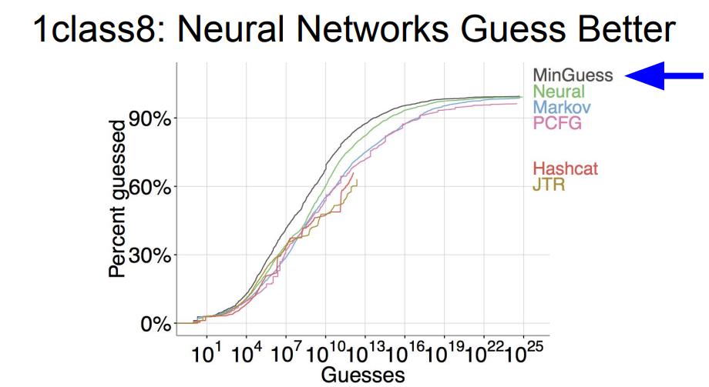
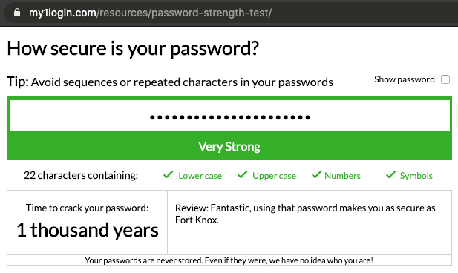

Slide 5
How Could we fix this Issue?

Slide 6
PIN Codes
Pros
They are tied to hardware
Shorter and easier to remember
Cons
Could be easier to guess
Organizations end up using PINs as passwords
PINs are not utilized the same way across all devices

Slide 7
One-Time Passwords (OTP)
Pros
Valid for limited time
Unhackable by conventional means
Cons
Can be Intercepted if it is sent to a compromised email or device
Requires some account information to already be entered to be effective

Slide 8
Biometric Authentication
Pros
User needs to be physically present
Easy to use requiring no extra device or remembering a password
Very hard to replicate
Cons
Biometric scans are sometimes stored and can be copied

Slide 9
How can we use these Optimally?

Slide 10
Multi-Factor Authentication (MFA)
Using multiple factors eliminates the cons of using just one
More factors means more safeguards against hackers
There is information that cannot be guessed
Password reliance can be eliminated

Slide 11
What can we Conclude?

Slide 12
Passwords
Alternatives
MFA
Easily guessable
Complex
Reused
Less complex
Easy to use
Have their own drawbacks by themselves
Use the strengths of multiple methods
Strengths cover others weaknesses
Conventional passwords can be eliminated

Slide 13
Works Cited
https://www.pentasecurity.com/blog/password-free-enterprise-pros-and-cons-of-each-password-alternative/
https://techgenix.com/password-alternatives/
https://www.usenix.org/conference/usenixsecurity16/technical-sessions/presentation/melicher
https://winmagic.com/blog/why-is-a-pin-better-than-a-password/
https://www.usenix.org/sites/default/files/conference/protected-files/security16_slides_melicher.pdf
https://www.spiceworks.com/it-security/identity-access-management/articles/why-adopting-mfa-is-important/

